Slide 1

Uno Platform – UWP everywhere
Martin Zikmund
@mzikmunddev
Notes:
Hello everyone, thank you for tuning in for my presentation. Today I would like to introduce you to the Uno Platform - C#- and XAML-based cross-platform app development framework that’s bringing Microsoft’s Universal Windows Platform everywhere.

Slide 2
Outline
Cross-platform app development
The Uno Platform
Demos
Call to action

Slide 3

Cross-platform app development
Notes:
The topic of my talk is cross-platform app development.
Challenging
Many approaches and frameworks
Ongoing search for ideal solution

Slide 4










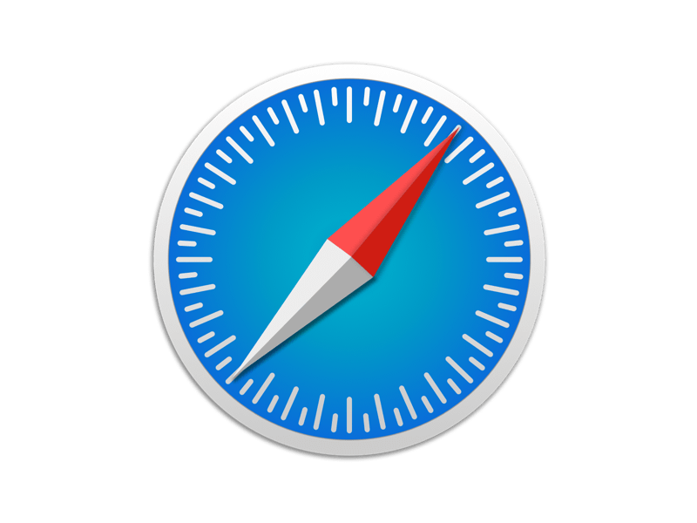
O(N) development time
/
/
Notes:
Traditional approach – native app for each OS
Requires a team of diverse developers proficient in each technology stack
Time to develop – O(N)
Time to fix bugs – O(N)
Time to develop new features – O(N)
No code-sharing

Slide 5

O(1) O(lg N) development time
+
Notes:
A better solution we want – single technology stack targeting all platforms
.NET world – C# + XAML – ideal combination
Code-sharing across multiple platforms
Lower
Development cost
Bugfixing cost

Slide 6

First attempt – Xamarin.Forms
XAML → platform UI controls
Simplified XAML and styling, different naming conventions
Width / WidthRequest
Background / BackgroundColor
Xamarin.Essentials
Notes:
First attempt at this goal
Originally - quick prototyping, line-of-business apps
Now - also consumer apps
XAML dialect – rendered with platform UI controls
Intent – create UI familiar to users of each platform
Simplified XAML
Only partial support for styling, templating
Different naming conventions vs. UWP and WPF
Background is not a brush – no gradient, etc.
HorizontalAlignment – HorizontalOptions
Mostly for UI, for other common features Xamarin.Essentials
Need to learn new API on top of existing platform skills

Slide 7
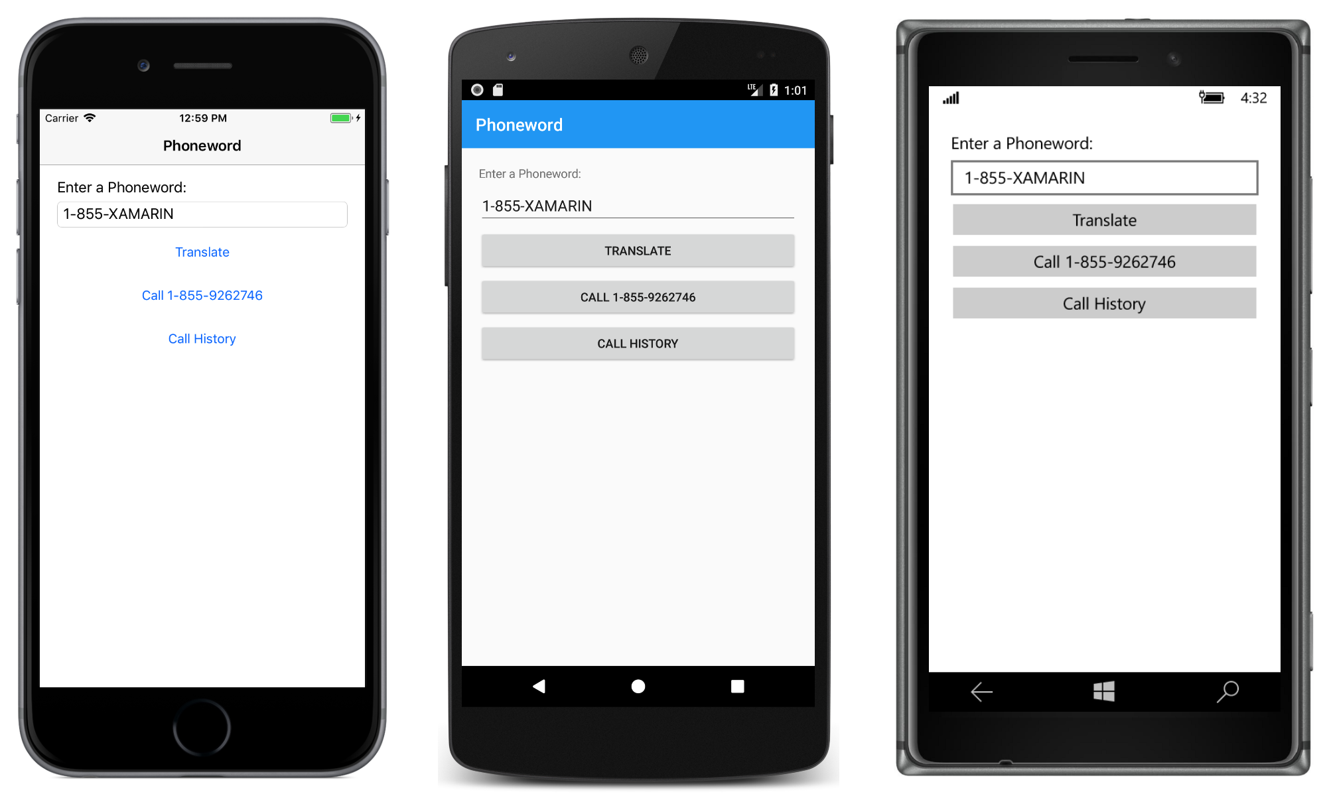
Xamarin.Forms UI comparison
Notes:
- Example of classic Xamarin.Forms UI side-by-side
Each platform looks differently
Hard to unify the design, consistency
Hard company branding
Often need to use renderers to fix oddities

Slide 8

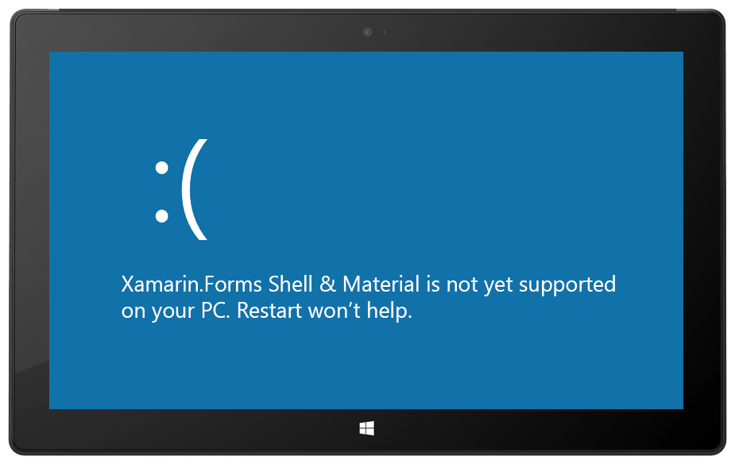
Xamarin.Forms Shell/Material design
Notes:
Team recognized the difficulties of building a branded app
Shell and material visual = solution
Still some differences, inconsistencies
No UWP support (in progress, but not officially supported)
UWP is key for smooth debugging and dev loop

Slide 9
Uno Platform
Port of Universal Windows Platform (UWP) API and XAML to iOS/Android/WASM/macOS
Written in C# (with bits of Java and JavaScript)
1:1 compatibility with UWP XAML, existing skills – consistent UI
Developed by nventive
Free and open source
https://platform.uno/
Notes:
Developed by nventive, based in Montreal, Canada
Open sourced in May 2018

Slide 10

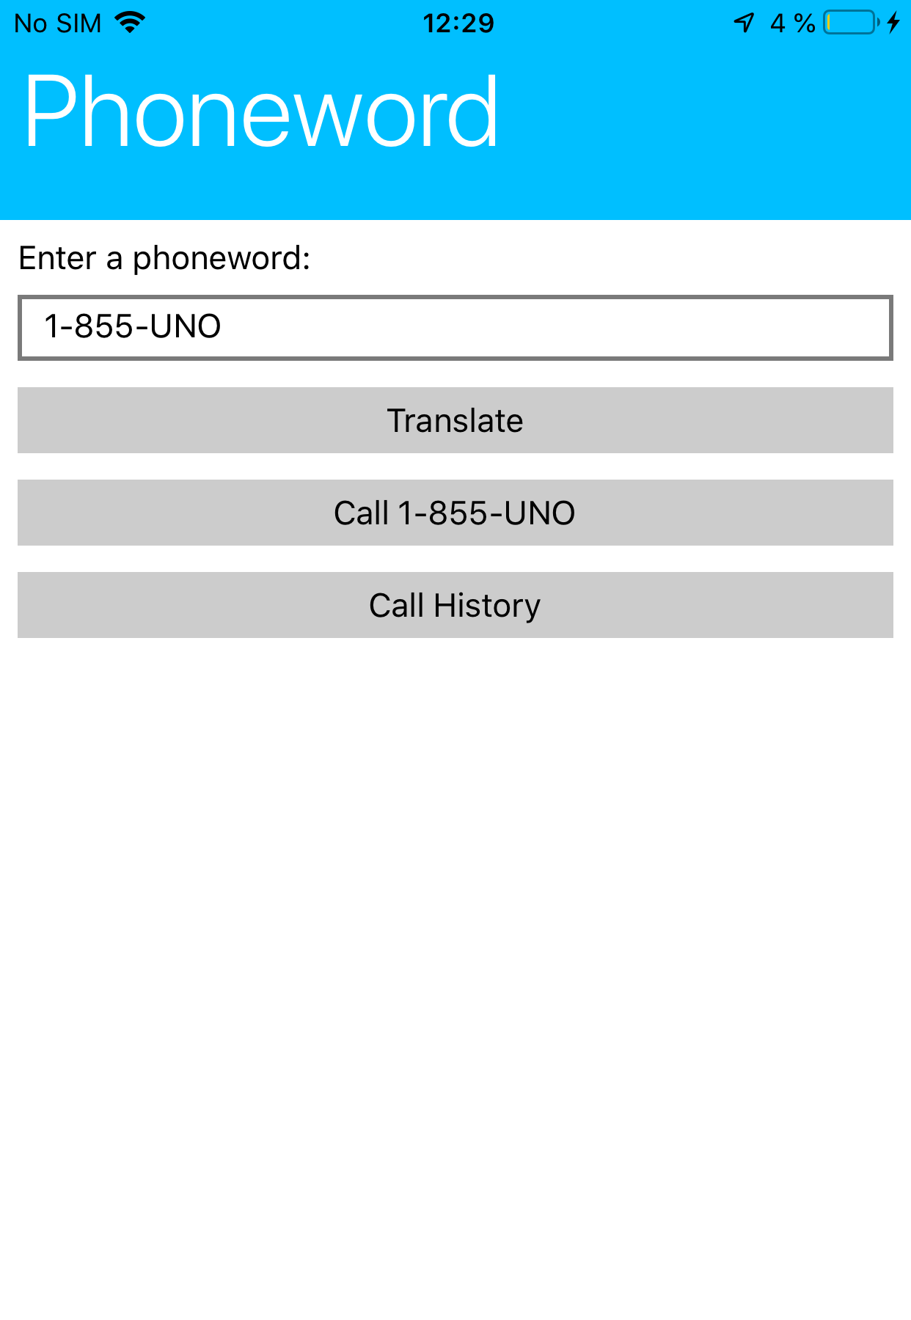
Uno Platform UI comparison
Android
iOS

Slide 11
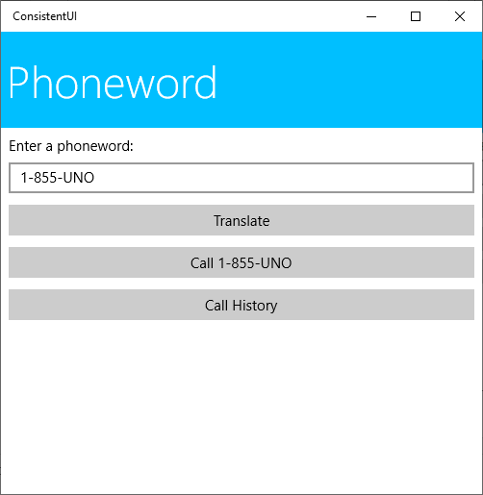
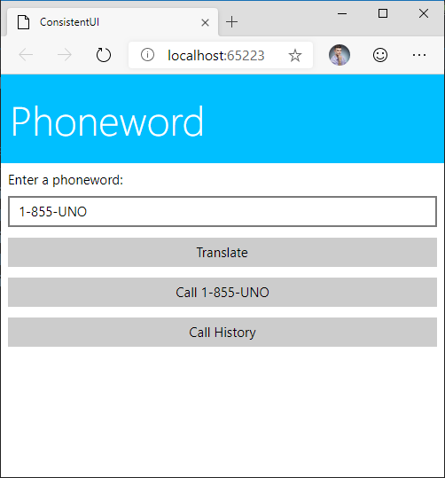
Uno Platform UI comparison
UWP
WebAssembly

Slide 12

Supported platforms
UWP
native
Android
stable
iOS
stable
Uno
WebAssembly
preview
macOS
very preview
Notes:
WebAssembly highlighted - support makes Uno unique

Slide 13
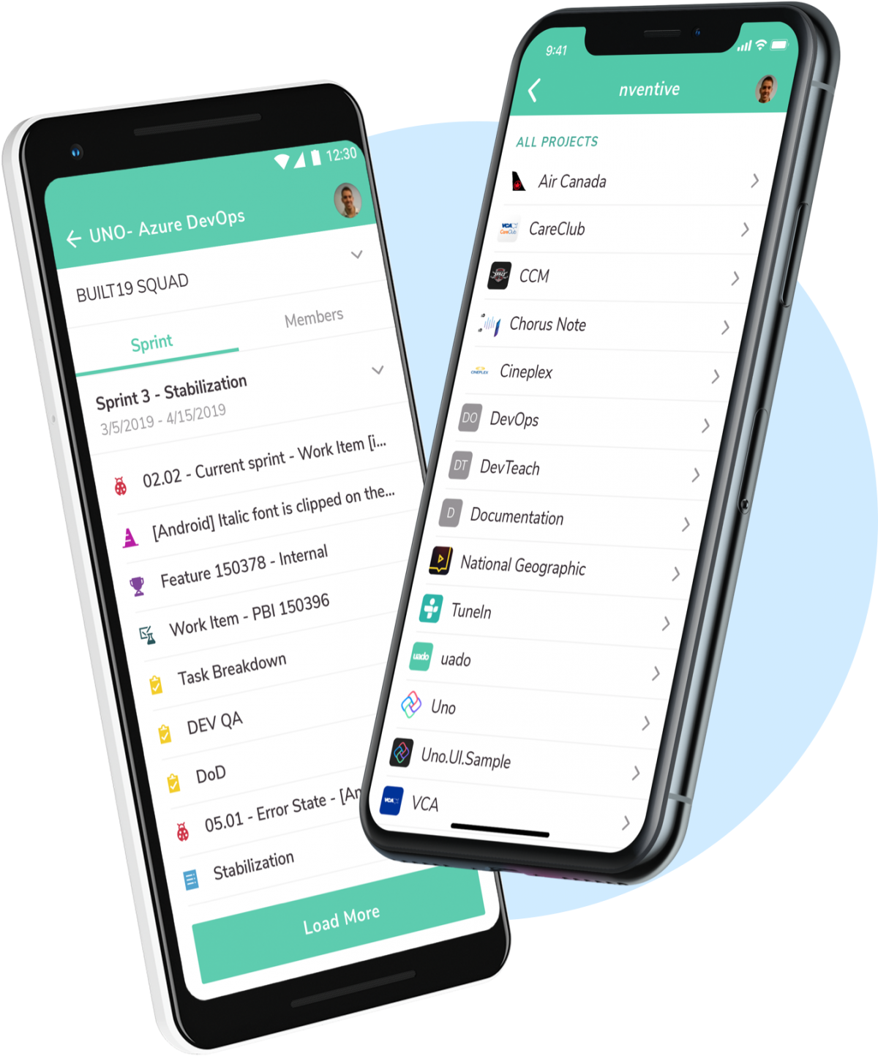
The Uno Philosophy
Leverage existing tools
Create rich, responsive apps
Let views do views
Native interoperability
Performance is a feature
Notes:
Build on shoulders of giants
Start with UWP app – do not care you are building cross-platform app
Use all Visual Studio tools
Rich animations, rich UI – UX matters
MVVM
Embed native controls in XAML, use platform-specific APIs, interop with Xamarin.Forms possible as well
Users do care about performance

Slide 14
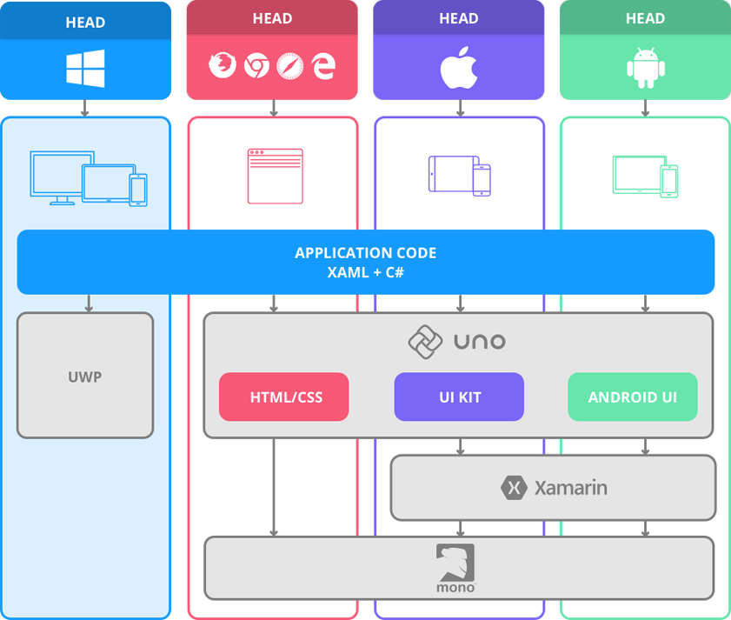
Notes:
- Brief look at architecture
UWP runs directly against Windows UWP API
Full support for Visual Studio tooling
WASM head
Render using HTML, CSS
Run on Mono
Android, iOS
Native UI libraries (UIKit, Android UI)
Xamarin for native API bindings
Mono
Result – all platforms – native performance

Slide 15
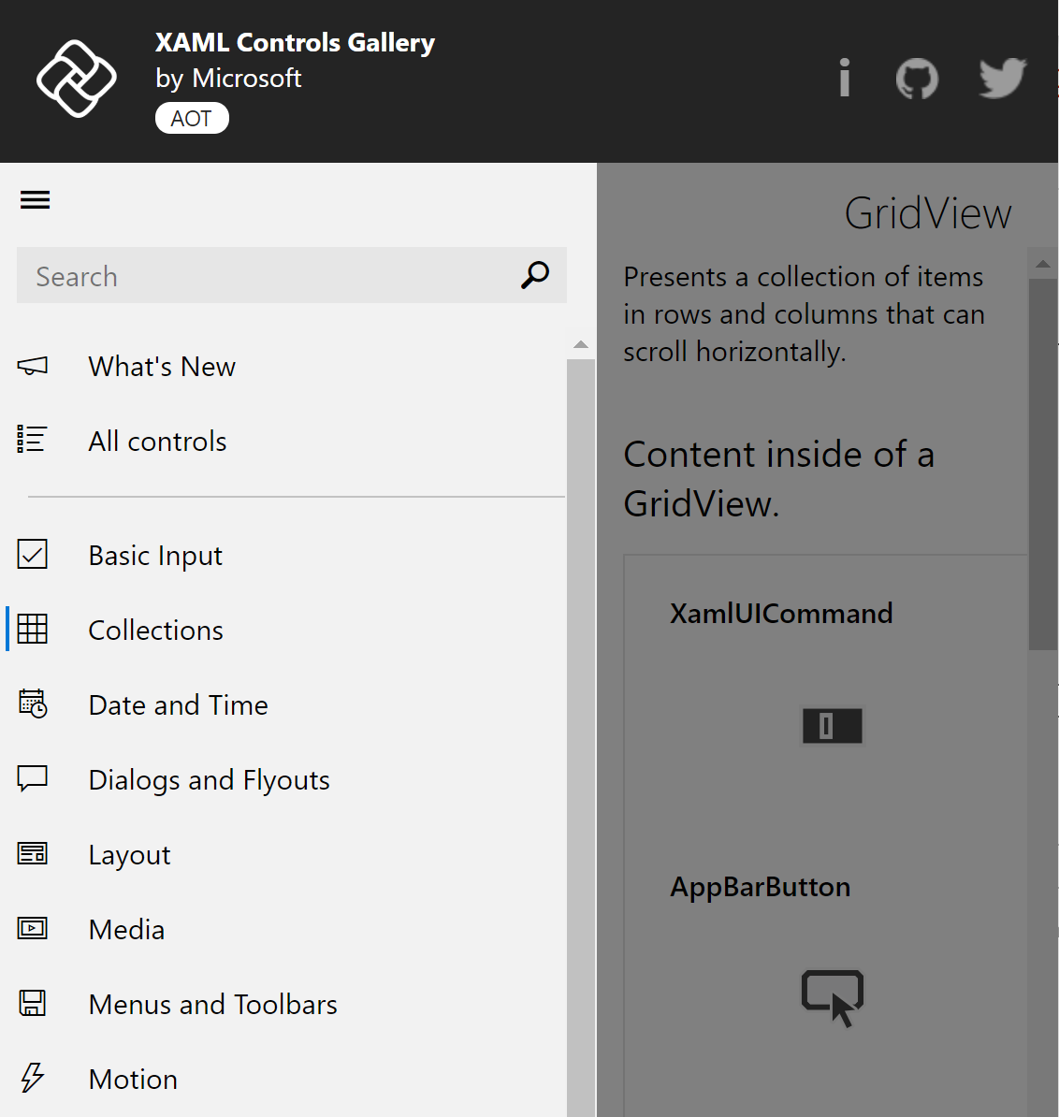
Uno UI
Control/Data templating, styling
Animations, VisualState, StateTrigger
Data binding
Shapes and Brushes
Conditional XAML
Native Controls embedding
https://xamlcontrolsgallery.platform.uno/
Notes:
Full compatibility with UWP XAML
Includes advanced features
Controls are templatable
Conditional XAML to tailor to specific platforms

Slide 16
Uno – UI? Not only!
PowerManager
MapLocationFinder
Launcher
SimpleOrientationSensor
Geolocator
DisplayInformation
BrightnessOverride
ApplicationData
SpeechRecognizer
ChatMessageManager
PasswordVault
Clipboard
StorageFile
MediaPlayer
And many more!
Notes:
Uno is not only about UI
No need to learn a new 3rd party library, many things out of the box and support keeps growing

Slide 17


Uno Platform Prerequisites
Visual Studio 2019 for Windows
Universal Windows Platform
Mobile development with .NET
ASP.NET and Web
macOS for iOS build host
Uno Platform Solution Templates Visual Studio extension

Slide 18

Demo Hello, Uno Platform
Notes:
Here show a pre-built demo app which has UWP UI with styling and stuff and then suddenly run the same on Android and iOS.

Slide 19
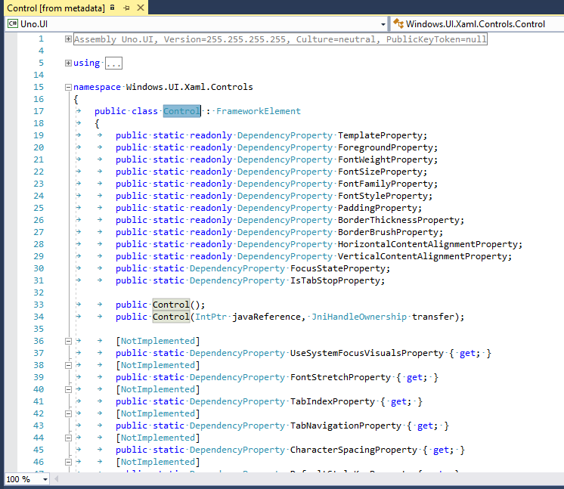
How does it work?
All UWP types and members are exposed by Uno.UI
Subset implemented by Uno
Any existing UWP C# code should compile with Uno
Non-implemented features will throw an exception at runtime
Non-implemented types, properties etc. are marked with the [NotImplemented] attribute and will show a warning in VS (Roslyn analyzer)

Slide 20
Uno namespaces = UWP namespaces
UWP
Uno Platform
Windows.UI.Xaml.Controls.Button
Windows.UI.Xaml.Controls.Border
Windows.UI.Xaml.Controls.Button
Windows.UI.Xaml.Controls.Border
Compiling for:
UWP – Windows.Foundation.UniversalApiContract
Android, iOS, WASM – Uno, Uno.UI

Slide 21
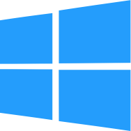



API to Native Mapping
TextBlock
Settings Storage
UILabel
NSUserDefaults
TextView
SharedPreferences
HtmlParagraph (<p>)
IndexedDB
UI
UI
UI
UI
Platform API
Platform API
Platform API
Platform API
Notes:
UWP controls and APIs map to native controls and APIs on every platform
Mapping is not direct (as opposed to Xamarin.Forms)
Support for styling and templates
More freedom in styling and possibility to add features not available on the native control
Goal is to be able to just copy-paste a UWP control template and make it look the same as on Windows

Slide 22
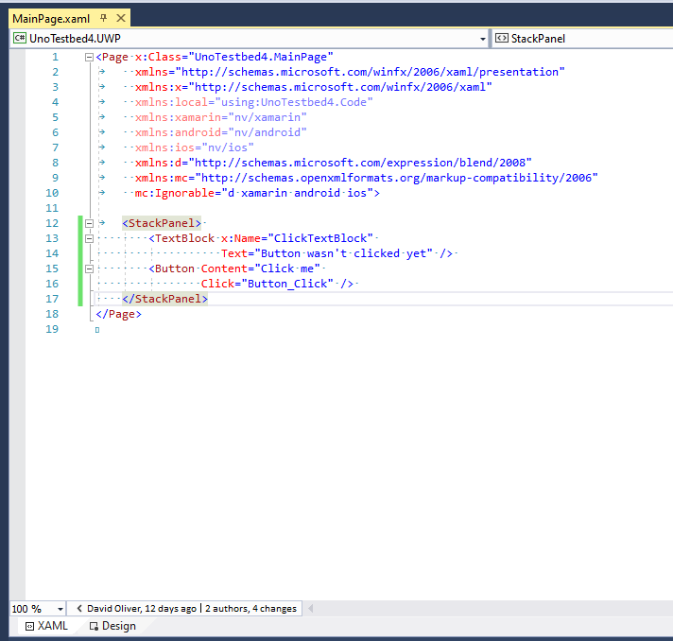
XAML Code generation
public sealed partial class MainPage : Windows.UI.Xaml.Controls.Page
{
private void InitializeComponent()
{
var nameScope = new global::Windows.UI.Xaml.NameScope();
NameScope.SetNameScope(this, nameScope);
// Source ..\..\..\..\..\..\UnoExtTestbed.Shared\MainPage.xaml (Line 1:2)
Content = new global::Windows.UI.Xaml.Controls.StackPanel
{
// Source ..\..\..\..\..\..\UnoExtTestbed.Shared\MainPage.xaml (Line 8:3)
Children =
{
new global::Windows.UI.Xaml.Controls.TextBlock
{
Name = "ClickTextBlock",
Text = "Button wasn't clicked yet",
// Source ..\..\..\..\..\..\UnoExtTestbed.Shared\MainPage.xaml (Line 9:4)
}
.MainPage_05a03e67d6a6581089c5d12899278d61_XamlApply((MainPage_05a03e67d6a6581089c5d12899278d61XamlApplyExtensions.XamlApplyHandler0)(c0 =>
{
nameScope.RegisterName("ClickTextBlock", c0);
this.ClickTextBlock = c0;
}
))
,
new global::Windows.UI.Xaml.Controls.Button
{
Content = @"Click me",
// Source ..\..\..\..\..\..\UnoExtTestbed.Shared\MainPage.xaml (Line 11:4)
}
.MainPage_05a03e67d6a6581089c5d12899278d61_XamlApply((MainPage_05a03e67d6a6581089c5d12899278d61XamlApplyExtensions.XamlApplyHandler1)(c1 =>
{
c1.Click += Button_Click;
}
))
,
}
}
Notes:
- optimized for machine readability, not human readability. Quote from Jerome: “the explicit casts to XamlApplyHandler were added when we found that the compiler was having to do a lot of computationally-expensive type inference. That one change doubled the compilation speed for large XAML files.”
https://medium.com/@unoplatform/talkin-bout-my-generation-how-the-uno-platform-generates-code-part-1-under-the-hood-7664d83c4f90

Slide 23
Mixins with Roslyn
DependencyObject is an interface in Uno (to support native view inheritance)
[global::Windows.UI.Xaml.Data.Bindable]
public partial class MyBindableObject : IDependencyObjectStoreProvider, IWeakReferenceProvider
{
private DependencyObjectStore __storeBackingField;
public Windows.UI.Core.CoreDispatcher Dispatcher => Windows.UI.Core.CoreDispatcher.Main;
private DependencyObjectStore __Store
{
get
{
if(__storeBackingField == null)
{
__storeBackingField = new DependencyObjectStore(this, DataContextProperty, TemplatedParentProperty);
__InitializeBinder();
}
return __storeBackingField;
}
}
public bool IsStoreInitialized => __storeBackingField != null;
DependencyObjectStore IDependencyObjectStoreProvider.Store => __Store;
public object GetValue(DependencyProperty dp) => __Store.GetValue(dp);
public void SetValue(DependencyProperty dp, object value) => __Store.SetValue(dp, value);
public void ClearValue(DependencyProperty dp) => __Store.ClearValue(dp);
public object ReadLocalValue(DependencyProperty dp) => __Store.ReadLocalValue(dp);
public object GetAnimationBaseValue(DependencyProperty dp) => __Store.GetAnimationBaseValue(dp);
public long RegisterPropertyChangedCallback(DependencyProperty dp, DependencyPropertyChangedCallback callback) => __Store.RegisterPropertyChangedCallback(dp, callback);
public void UnregisterPropertyChangedCallback(DependencyProperty dp, long token) => __Store.UnregisterPropertyChangedCallback(dp, token);
private readonly static IEventProvider _binderTrace = Tracing.Get(DependencyObjectStore.TraceProvider.Id);
private BinderReferenceHolder _refHolder;
public event Windows.Foundation.TypedEventHandler<DependencyObject, DataContextChangedEventArgs> DataContextChanged;
partial void InitializeBinder();
…
public partial class MyBindableObject : DependencyObject
{
public string MyProperty
{
get { return (string)GetValue(MyPropertyProperty); }
set { SetValue(MyPropertyProperty, value); }
}
// Using a DependencyProperty as the backing store for MyProperty. This enables animation, styling, binding, etc...
public static readonly DependencyProperty MyPropertyProperty =
DependencyProperty.Register("MyProperty", typeof(string), typeof(MyBindableObject), new PropertyMetadata(default(string)));
}
Notes:
Uno uses Roslyn to create mixins for DependencyObject implementations and for view types
https://hackernoon.com/talkin-bout-my-generation-how-the-uno-platform-generates-code-part-2-under-the-hood-9970ac38ad06

Slide 24
Demo A peek under the hood
Notes:
Show the Uno.UI solution, demonstrate multi targeting, xyz.platform.cs, #if directives, show on some examples like Launcher, DisplayInformation, show view hierarchy on different systems
Link to the Contributing to Uno blogposts on blog

Slide 25

Third-party libraries
Uno = new target platform
Forks of existing third-party libraries
Windows Community Toolkit
Prism
Telerik UI for UWP
WindowsStateTriggers
Experimental Lottie support (https://lottie.platform.uno/)
Notes:
Uno supports 3rd party libraries
Forks of many OSS projects
Uno is basically a new target platform

Slide 26

Uno ♥ WebAssembly
Key platform
Full-featured WASM UI framework
See Build 2019 session about WASM by Jerome Laban, nventive CTO
https://youtu.be/mhoEqkJQlkY

Slide 27
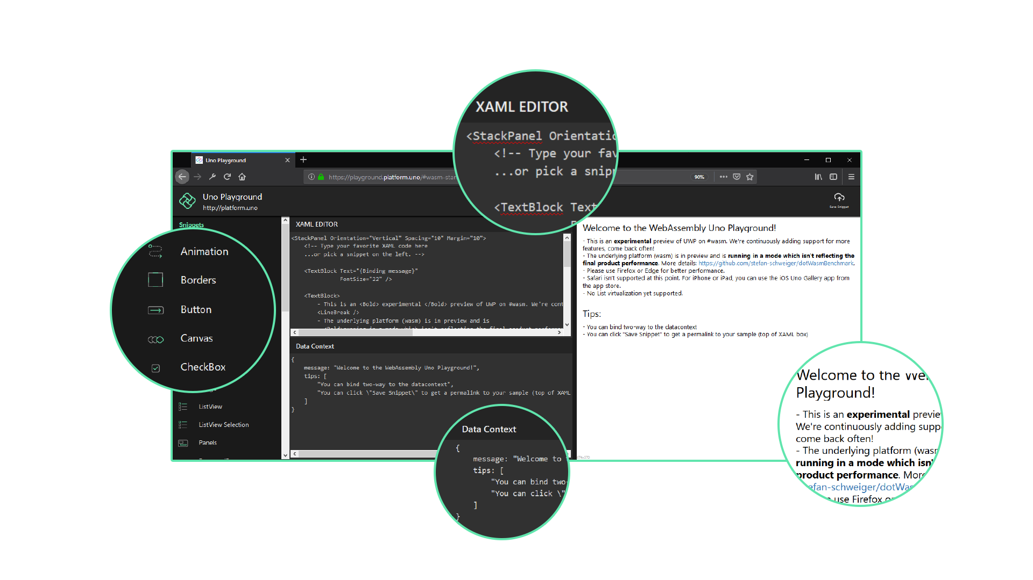


Uno Platform Playground
Uno Gallery App
Built with Uno to demo Uno
XAML EDITOR
SAMPLES LIST
XAML VISUALIZER
DATACONTEXT EDITOR & VISUALIZER
Notes:
Say that this is an app made using Uno to demo Uno

Slide 28





Uno Platform Playground
Android
https://bit.ly/2HDl2S9
iOS
https://apple.co/2QowZhg
WASM
https://playground.platform.uno/

Slide 29

Call to action
Submit feedback
&
Contribute
Create app with Uno
https://github.com/nventive/Uno
https://platform.uno/
https://bit.ly/2WvknKL
https://bit.ly/2JKIRtl
Notes:
Add link to contributing to Uno blogposts

Slide 30






Resources
https://github.com/MartinZikmund/meet-uno-talk
https://blog.mzikmund.com/
@mzikmunddev
@mzikmunddev
mzikmunddev
https://github.com/MartinZikmund/
Notes:
Add Link to Uno Medium blog
I wish you all a great day and I look forward to see what you create with Uno Platform!

